Slide 1


SDM COLLEGE OF ENGINEERING & TECHNOLOGY, DHARWAD – 580002
(An autonomous Institution affiliated to Visvesvaraya Technological University, Belagavi – 590018)
Department of Electronics and Communication Engineering
Minor Project On
“Hand Gesture Controlled Robot”
by
ECE B Division(6th semester)
Mr. YATHISH H BHAT – USN : 2SD19EC125
Mr. UJWAL SHETTIGAR – USN : 2SD19EC113
Mr. SHAIK NISAR – USN : 2SD19EC088
Mr. MANJUNATH GOUDA – USN : 2SD19EC049
Under the guidance of
Prof. M. Vijay Kumar
Academic year 2021-2022
1

Slide 2
Table of Contents
SL.NO. | TITLE | SLIDE NO.
1 | What is Robot? | 3
2 | Introduction | 4
3 | Literature Survey | 5
4 | Objectives | 6
5 | Problem Statement | 7
6 | Methodology | 8
7 | Block Diagrams | 9
8 | System Flow Chart | 10
9 | Requirements | 11
10 | Circuit Diagrams | 16
11 | Working | 18
12 | Applications | 21
13 | Future Scope | 22
14 | References | 23
2

Slide 3

What is Robot ?
02
01
Robot is an electromechanical machine that can perform tasks automatically
Robots are autonomous and semi autonomous
03
Robots plays an important role in military , medical , manufacturing etc…
Robots are needed to operate at high speed and with great accuracy.
04
3

Slide 4
Introduction
Gestures provide an interface to both human and computer.
Thus such gesture-based interfaces can not only substitute the common interfaces devices but can also be able to extend their functionality.
So we have implemented accelerometer-based Hand Gesture Control Robot by using Arduino UNO and Lilypad Arduino.
The project is based on wireless communication, where the data from the hand gestures is transmitted to the robot over a link (Transmitter – Receiver pair).
4

Slide 5
Literature Survey
S.no | Paper and Publications | Author | Contents
1 | Movement of robot using gestures of human | Prem Kumar | A wireless connection is used and helps to connect with robotic car and part of the body
2 | Gesture movement for physically impaired persons | Pooja Pawar | Robot can directly contact to people it will help to disable people for movement of wheel chair
3 | Gesture control using raspberry pi | Vijayalakshmi | The main objective of this project is to create a hand gesture recognition robot
4 | Gesture to control the overall performance of a smart city | Dinesh Bhushare | This paper proposes a system to recognize the hand gestures of people using an inexpensive Raspberry pi
5

Slide 6
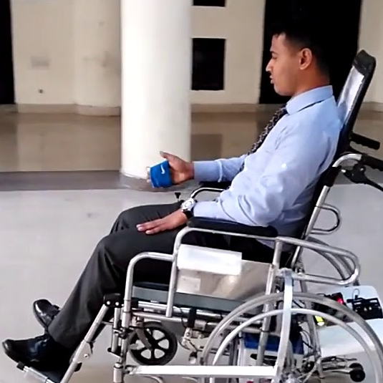
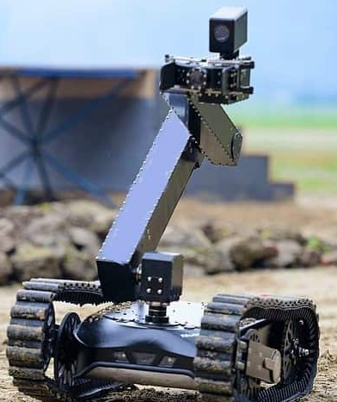
Objectives
The main objective is to make this device simple as well as economical so that it could be mass produced and can be used for the number of applications such as
The physically challenged disabled person confined to wheel chair
In Military Remote Surveillance
6

Slide 7
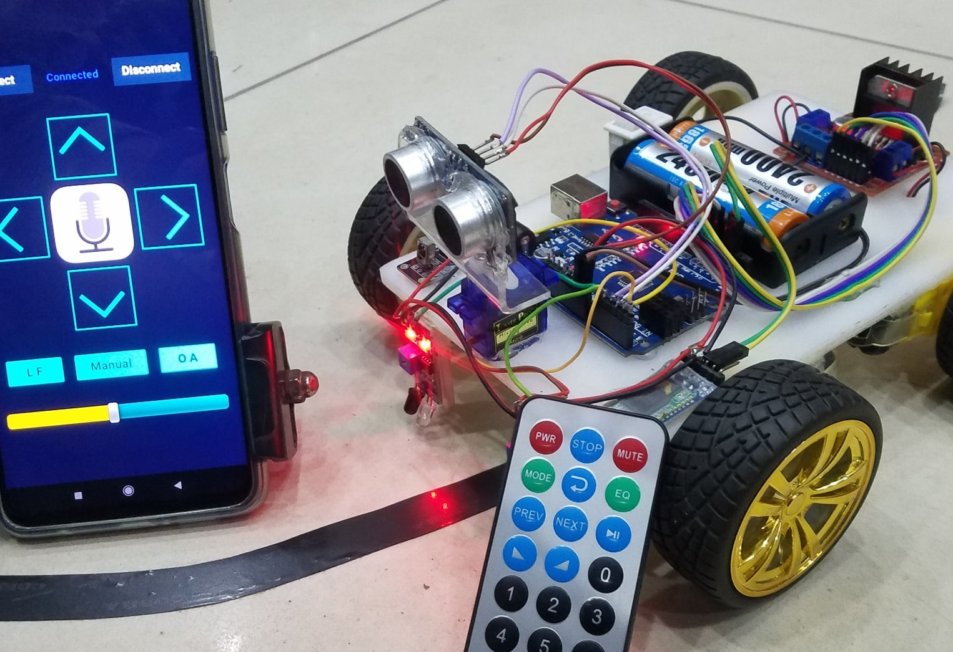
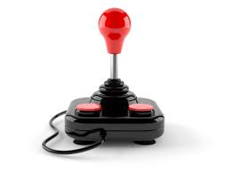
Problem Statement
The traditional wired button , remote , mobile controlled or using joystick for controlling the robot becomes very bulgy and it also limits the distance robots goes
The basic idea of our project is to develop a system (Robot) which can recognize the human interaction with it to accomplish certain task assigned to it by human hand gesture trajectories
7

Slide 8
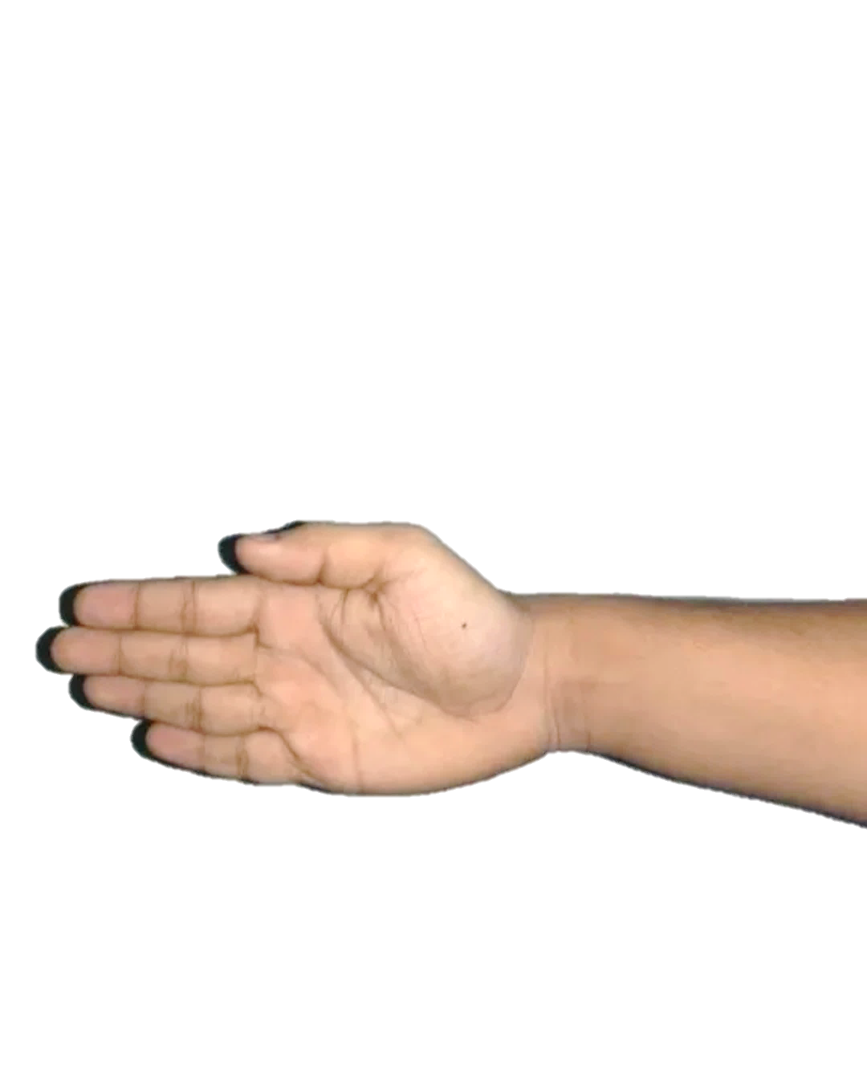
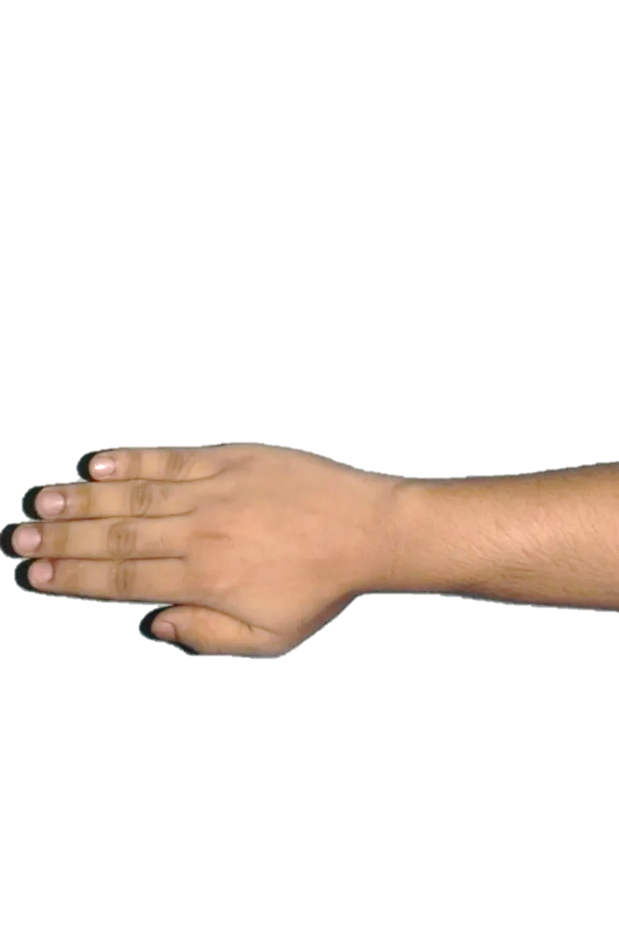
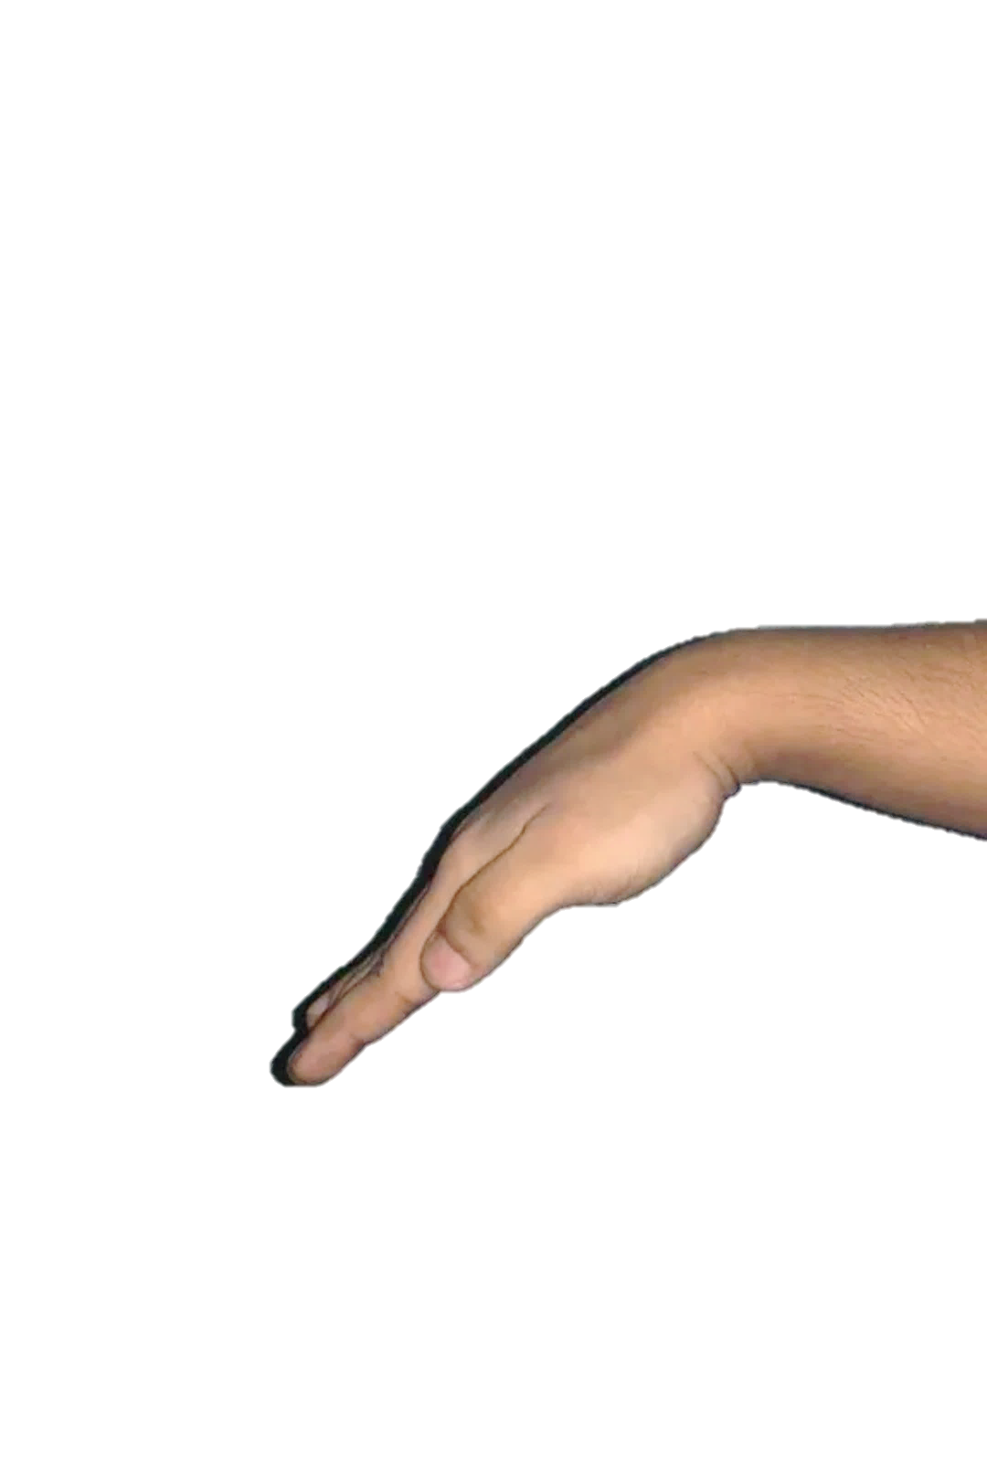
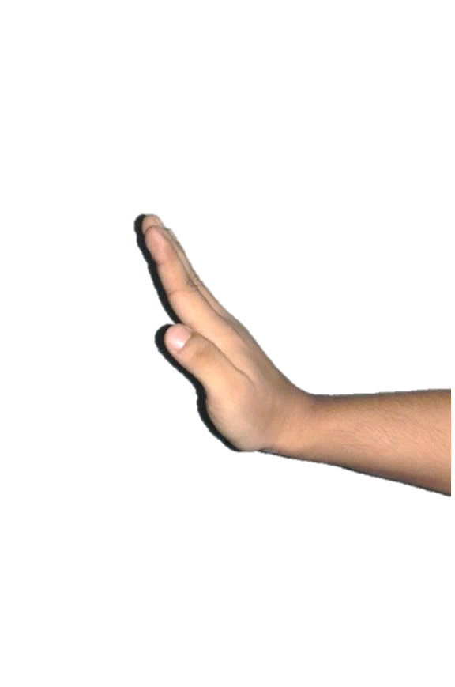
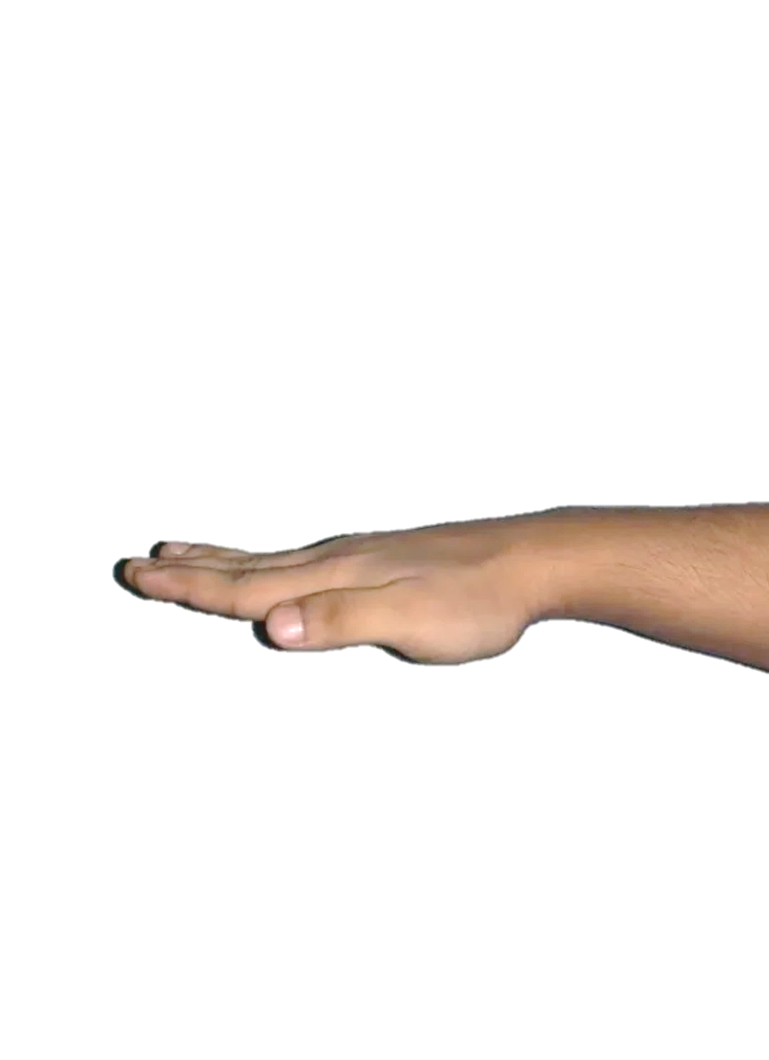
Methodology
Right
Left
Forward
Backward
Stop
A Gesture is an action that has to convey a some piece of information or a data
The Wireless Hand Gesture controlled Robot will function by a wearable hand glove from which the movements of the hand can be used as the input for the movement of the robot.
In our project we have designed a wearable Hand Glove which will contain the sensors mounted on it to capture the movement of the hand and convert the raw mechanical data into electrical form
8

Slide 9
Block Diagrams
Transmitter data
MPU-6050 Sensor
Lilypad Arduino
HC-05 (Master) Transmitter
Transmitter Block
Receiver data
Gesture Control
L298N Motor Driver Module
Arduino UNO
HC-05(Slave) Receiver
Robot
Receiver Block
9

Slide 10
System Flow Chart
start
MPU-6050 Sensor
Lilypad Arduino
Particular value transfer
Hand gestures
Data transfer
Convert data into angles value of
range 0 - 180°
Signals
transfer
HC-05 slave
HC-05 master
Arduino
Uno
Data received
Angle
measurement
Checking of angles
X range >=45° & <=55°
Y range >=145° & <=155°
Y range <140°
Y range >160°
X range <40°
X range >60°
Forward
Back
Left
Right
Stop
Data transfer
End
Car Movement
Motor Shield
L298N
10

Slide 11
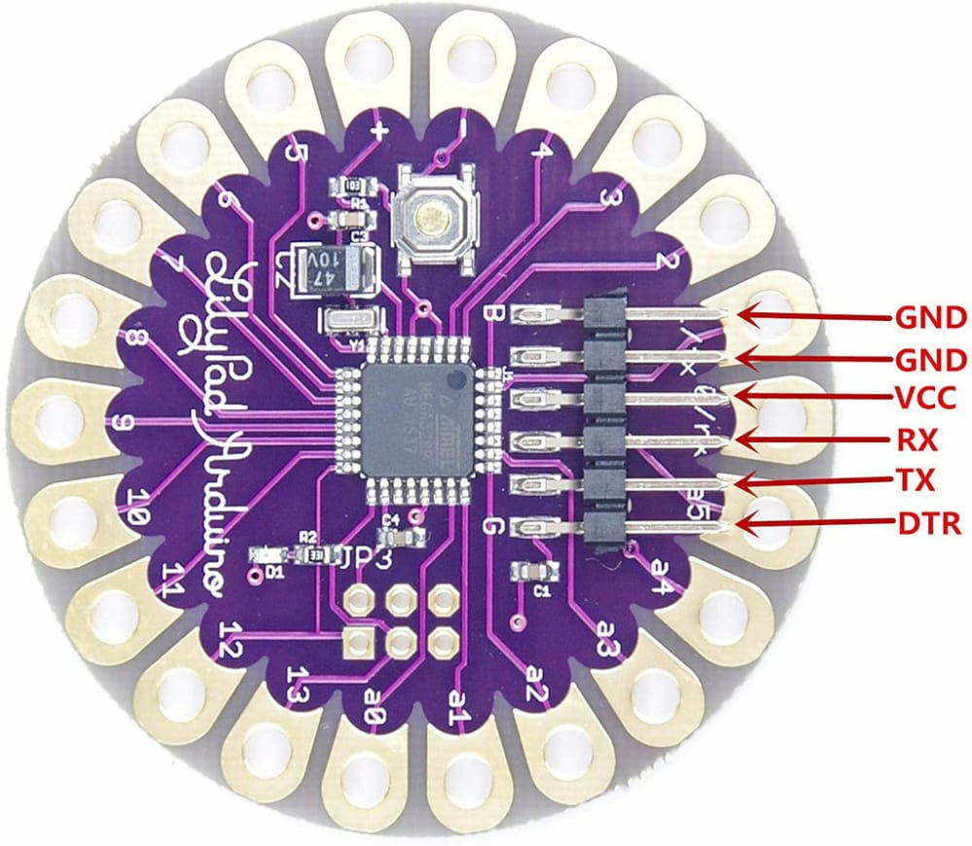
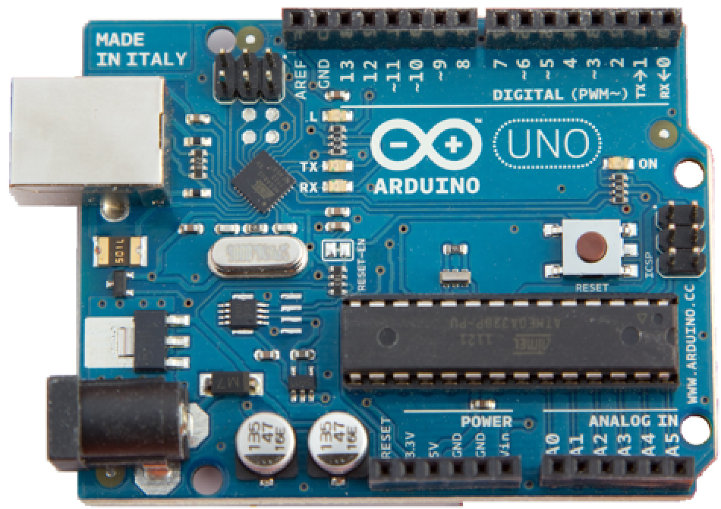
Requirements
Hardware :
Lilypad Arduino
Arduino Uno R3
Arduino UNO is a microcontroller board based on the ATmega328. It has 14 digital input/output pins
It is an open source electronic prototyping board which can be programmed easily
The Lily Pad Arduino 328 Main Board is an Arduino-programmed microcontroller designed to be easily integrated into e-textiles and wearable project
11

Slide 12
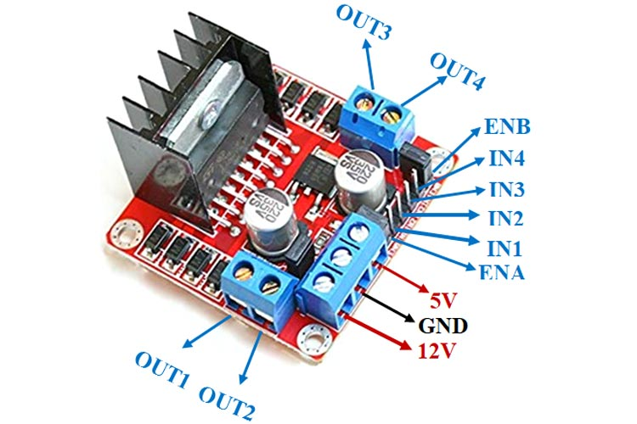
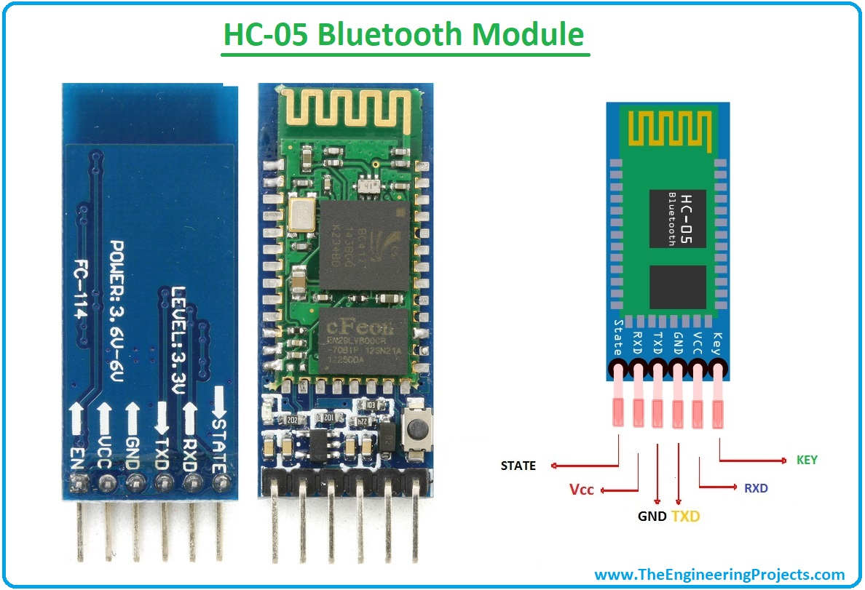
Other Hardware components
HC-05 Bluetooth Module
L298N MOTOR Driver Module
HC-05 is a Bluetooth module which is designed for wireless serial communication .
This module is used in master or slave configuration.
HC-05 has two operating modes , one is the data mode in which it can send and receive the data from other and another is AT command mode where default device settings can be changed
L298N Motor Driver Module is a high power motor driver module for driving DC and Stepper Motors.
It can control up to 4 DC motors, or 2 DC motors with directional and speed control.
12

Slide 13
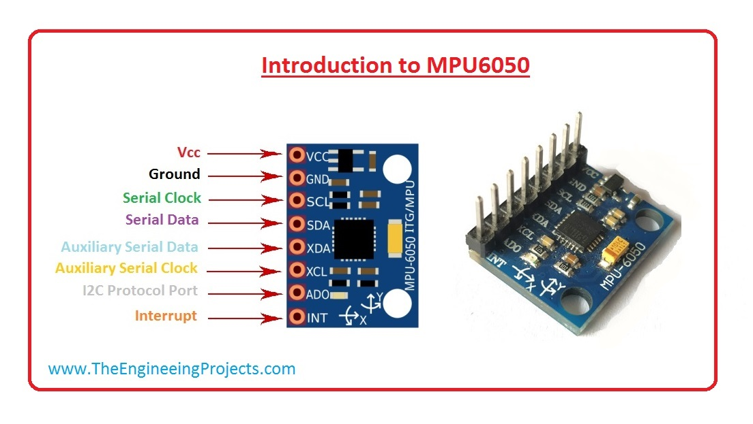
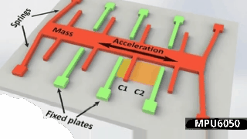
ACCELEROMETER SENSOR
MPU-6050 Module
The MPU6050 module is a Micro Electro-Mechanical Systems (MEMS) which consists of a 3-axis Accelerometer and 3-axis Gyroscope inside it.
This helps us to measure acceleration, velocity, orientation, displacement and many other motion related parameter of a system or object.
13

Slide 14
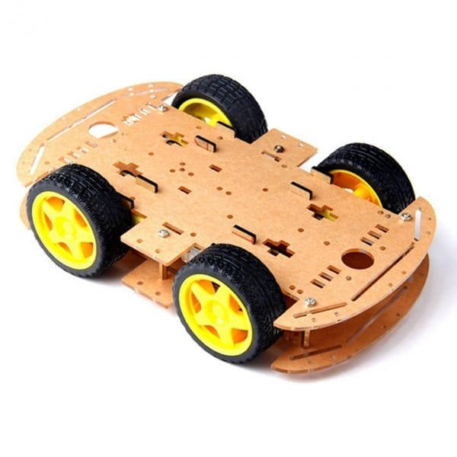
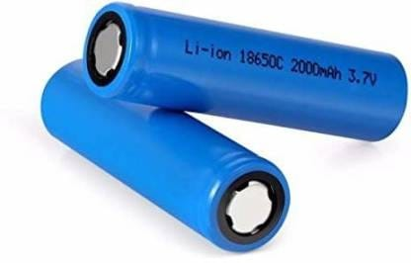
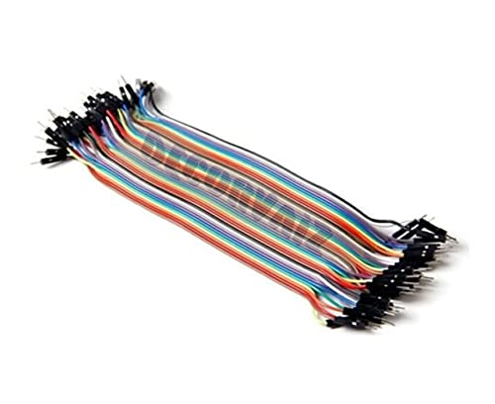
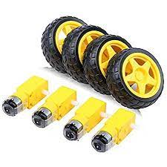
Car Chassis
Lithium ion batteries
BO DC Motor
Jumper wires
14

Slide 15
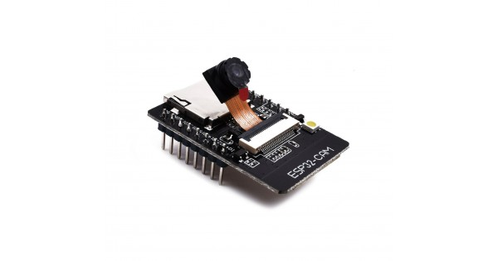
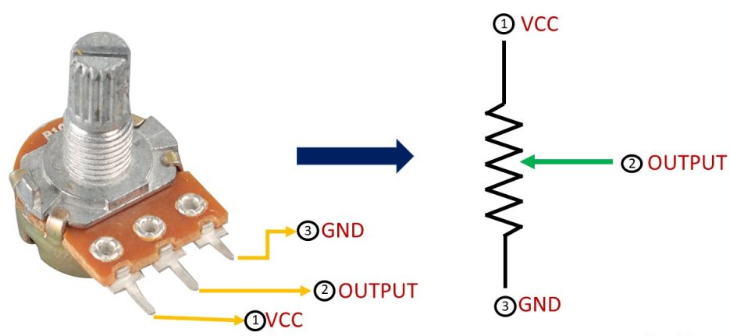
Additionally Used Components
The ESP32-CAM is a small size, low power consumption camera module based on ESP32. It comes with an OV2640 camera and provides onboard TF card slot.
The ESP32-CAM can be widely used in intelligent IoT applications such as wireless video monitoring, WiFi image upload , QR identification, and so on.
A potentiometer is a manually adjustable variable resistor with 3 terminals.
This type of pot is often used in audio volume control and Speed Control as well as many other applications.

Slide 16

Software
Arduino IDE
The open-source Arduino IDE software makes it easy to use and upload the code to the boards such as Arduino UNO, ESP32, Node MCU etc.
The Arduino IDE supports the languages C and C++ using special rules of code structuring
16

Slide 17
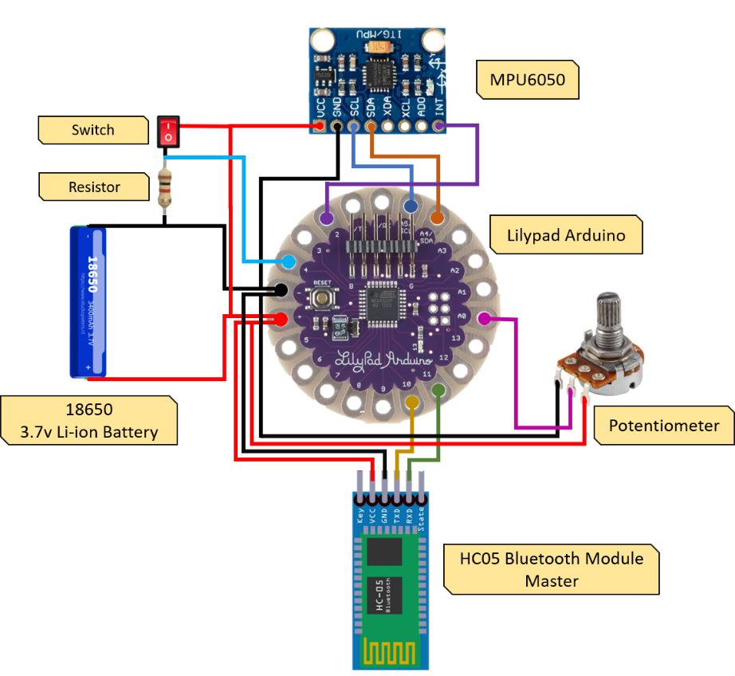
Circuit Diagrams
Transmitter Circuit
17

Slide 18
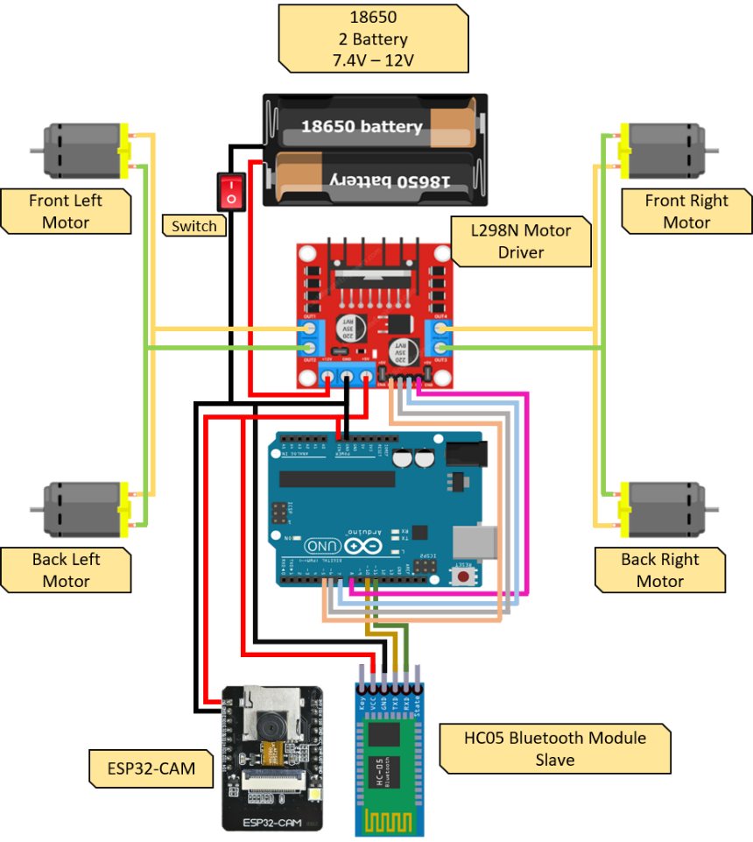
Circuit Diagrams
Receiver Circuit
18

Slide 19
Working
The whole project is divided into two sections one is the transmitter section and the other is the receiver section..
The Gesture controlled robot moves according to hand movement as we place transmitter in our hand.
When hand is tilted in front side, robot start to moving forward and continues moving forward until next command is given.
When hand is tilted in backward side, robot change its state and start moving in backwards direction until other command is given.
When hand is tilted in left side Robot get turn left till next command.
When hand is tilted in right side robot turned to right. And for stopping robot hand is kept stable . This is the working of hand gesture control robotic system
19

Slide 20
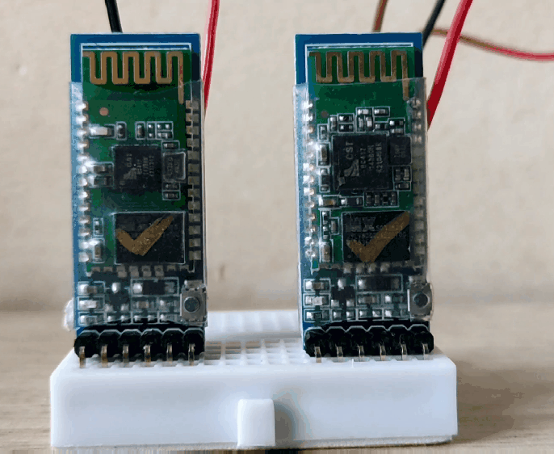
HC-05 Bluetooth Pair Configuration
To Configure and Pair HC-05 Module as Master and Slave we use the AT Command Modes
Master Configuration | Slave Configuration
AT+RMAAD | AT+RMAAD
AT+ROLE=1 | AT+ROLE=0
AT+CMODE=0 | AT+ADDR
AT+BIND=98d3,34,906554 | AT+UART=38400,0,0
AT+UART=38400,0,0 | Commands entered are replied with "OK"

Slide 21
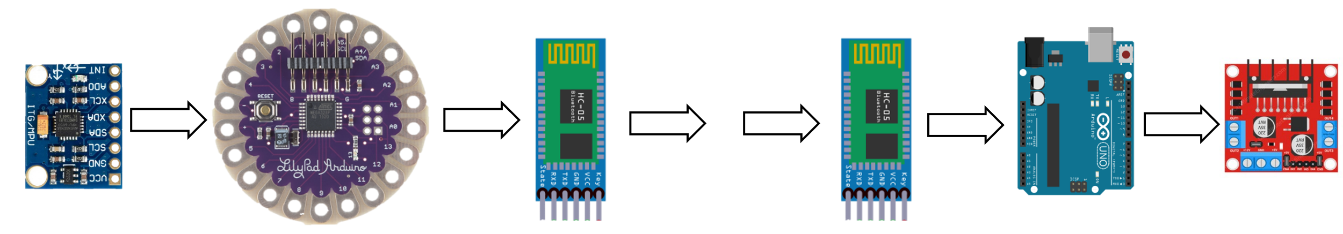
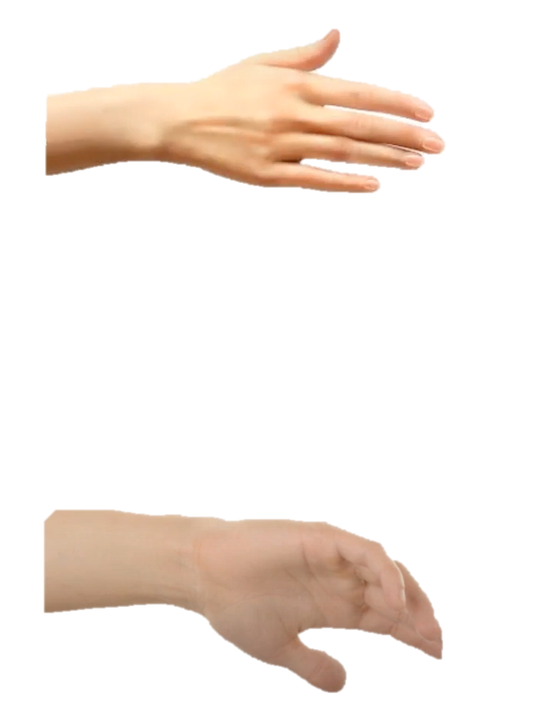
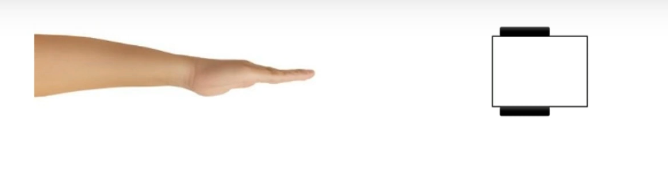
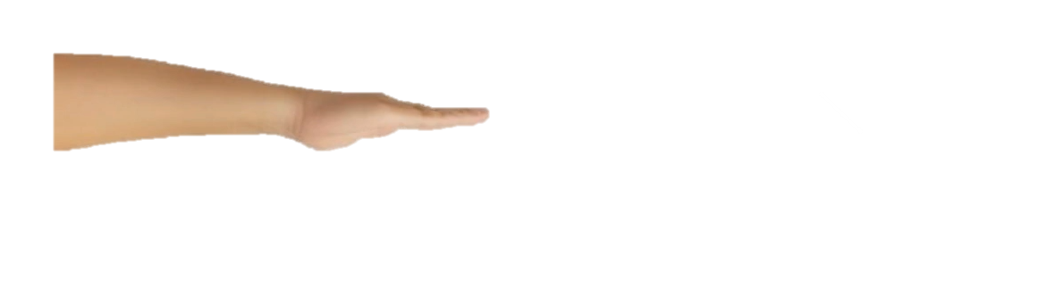
Stop
Forward
Backward
Right
Left
Transmitter Unit
Receiver Unit
‘S’
‘R’
‘S’
‘R’
‘S’
‘S’
‘R’
‘B’
‘R’
‘L’
‘B’
‘L’
‘B’
‘B’
‘L’
‘F’
‘L’
‘F’
‘F’
‘F’
Transmits Data
Receives Data
21

Slide 22
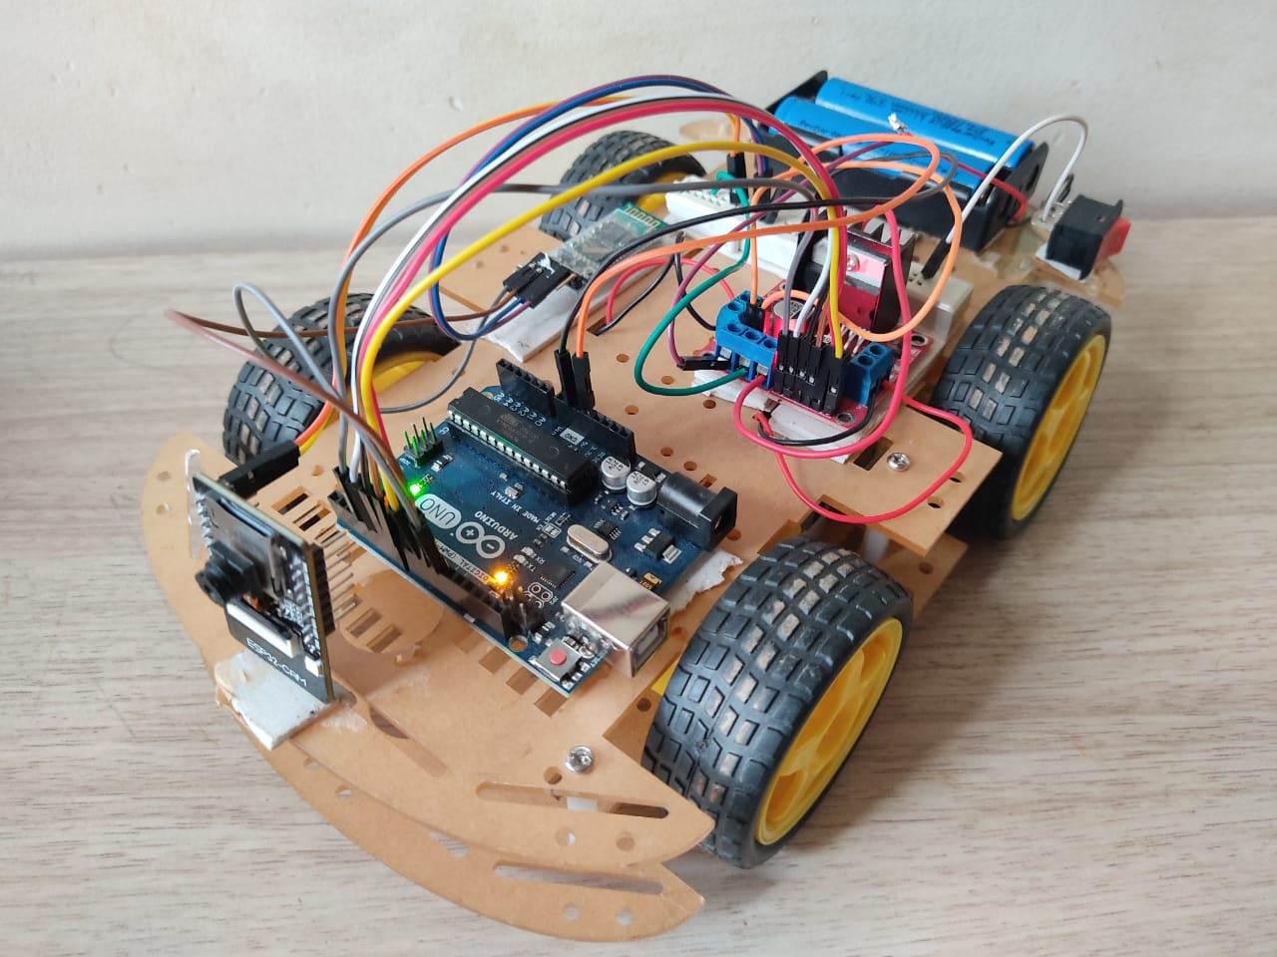
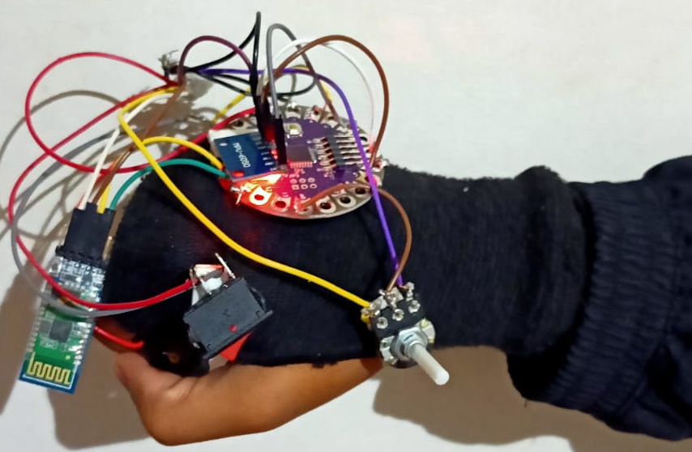
Work done Images
Transmitter (Hand Glove)
Receiver (Robot)
22

Slide 23
Cost Analysis
Sl. No. | Components | Quantity | Cost
1 | Car chassis | 1 | 700
2 | Arduino Uno | 1 | 499
3 | Lilypad Arduino | 1 | 261
4 | HC05 Bluetooth Module | 2 | 416
5 | MPU6050 | 1 | 116
6 | Battery Holder | 1 | 24
7 | Lithium ion Battery | 3 | 174
8 | TP4056 Battery charging module | 1 | 23
9 | Potentiometer | 1 | 12
10 | ESP32 Cam | 1 | 490
11 | L298N Motor Driver Module | 1 | 125
12 | Switches | 2 | 20
13 | Jumper wires | 50 | 80
Total Cost | ₹2940
23

Slide 24
Applications
Wireless controlled robots are very useful in many applications like remote surveillance, military etc.
Hand gesture controlled robot can be made useful by physically challenged in wheelchairs
Hand gesture controlled industrial grade robotic arms can be developed.
Fire: To provide video feedback of the site for analysis. Geological surveys for e.g., Caves
It can be used in wildlife conservation centers to monitor animals using its live video stream.
24

Slide 25
Conclusion
We have successfully implemented a hand-gesture-based interface for navigating a car-robot with some additional features such as control of speed and Esp-32 cam video monitoring of the robotic car .
A user can control a car-robot directly by using his or her hand trajectories. In this project accelerometer based hand gesture-controlled robot works based on accelerometer outputs, which correspond to hand movements and sends that data to the lily pad Arduino which assigns specific value to the movements.
This information is transferred through the HC-05 Bluetooth Module (Master) to the receiver of robot. On the other end, the information is received wirelessly via HC-05 Bluetooth Module (slave).
These decisions are sent to the motor driver, which triggers the motors in specific configurations to make the robot move in different directions.
Thus this proposed system will be helpful in various applications and will surely fulfil in all aspects and provide benefits to society and the people
25

Slide 26
Future Scope
The future of gesture controlled technology is very promising.
Video gaming will become more interesting and creative with the help of hand gesture control technology
Discovery people for their studies on animals by playing different sounds & for their exploration.
GPRS and GPS modules can be added for place location. A Video Camera can be added for Live streaming.
We can add bomb and metal detectors and can send to place, harmful for a person to go.
Gesture controlled robots has a potential in growing market all around the world.
26

Slide 27
References
Ch. Prem Kumar and Salumari Madhu, “Gesture Control Robot with Arduino,” IOP Conference Series: Materials Science and Engineering, vol. 455, conference 1, 2018.
S. Siddharth Rautaray, and Anupam Agrawal, “Real Time Gesture Recognition System for Interaction in Dynamic Environment,” in Procedia Technology, vol. 4, pp. 595-599, 2012
Dinesh Kumar Bhusare, Shilpa Karale, Pooja Pawar and R. K. Sarawale, “Hand Gesture by Using Robotic Car Control,” in International Journal of Advanced Research in Computer Engineering & Technology, vol. 4, no. 3, pp. 830-833, March 2015
Vijaya Laxmi, “Image Processing Based Hand Gesture Controlled Robot On Raspberry Pi,” in International Journal of Engineering & Science Research, vol. 6, no. 3, pp. 49-54, March 2016.
27

Slide 28
Acknowledgement
It is always a pleasure to remind the fine people in the “SDM COLLEGE OF ENGINEERING AND TECHNOLOGY DHARWAD” We consider it a privilege to express our sincere gratitude and respect to all those who guided and inspired us for this project.
We express our heartfelt thanks to our guide Prof. M Vijay Kumar, Assistant Professor, Department of Electronics and Communication, SDM College of Engineering and Technology, Dharwad, for his valuable guidance and suggestions.
We are humbly thankful to Prof. Dr. Vijaya C, H.O.D., Department of Electronics and Communication, SDM College of Engineering and Technology, Dharwad, for providing us with all the facilities that were required.
We would like to express our immense gratitude to Dr. K. Gopinath, Principal SDM College of Engineering and Technology, Dharwad, for his timely help and inspiration.
We would like to express our immense gratitude to our friends and seniors for providing some of the components which is required in our project.
28

Slide 29
THANK YOU
29

